Slide 1

MOST POPULAR COMPONENTS IN SYNCFUSION
DONE BY
S DHANUSH

Slide 2
MOST POPULAR COMPONENTS
DataGrid
Charts
List viewer
Scheduler
Diagram
PDF Viewer
Excel Library

Slide 3
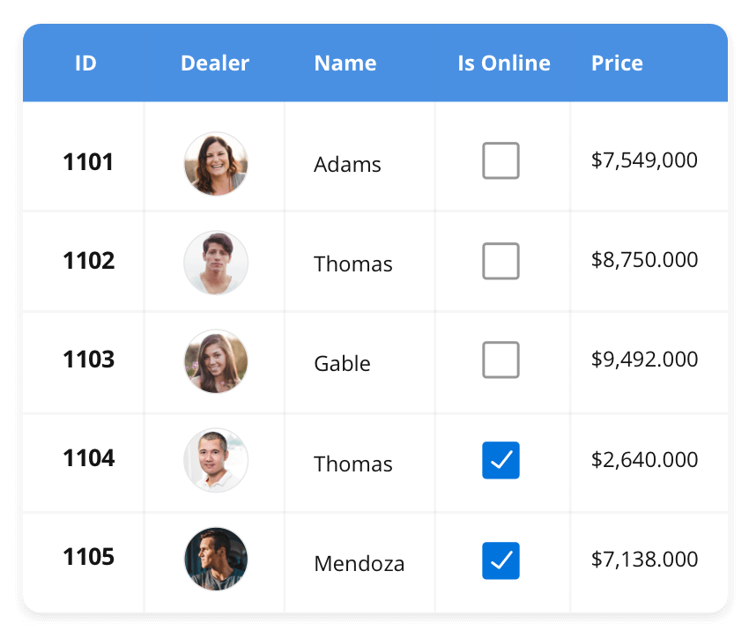



DATAGRID
The List View renders a set of data items with UI views or custom templates. It has many features like grouping, sorting, filtering, paging, swiping, multiple selection, drag and drop, and different layout types. The List View control has been optimized to work with large amounts of data.
SUPPORTED PLATFORMS
JavaScript | Angular | React | Vue | Blazor
Flutter | ASP.NET MVC | ASP.NET Core
Winforms | WPF | WinUI | Flutter | Xamarin
UWP | .NET MAUI
Xamarin | Flutter | UWP | JavaScript | .NET MAUI

Slide 4
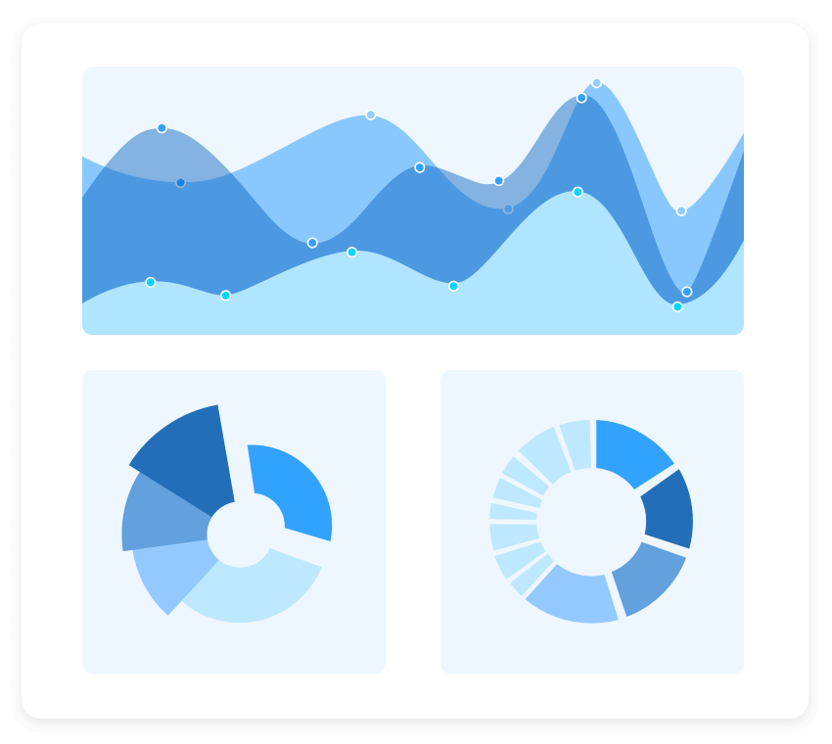
CHARTS
The Charts control can plot a wide range of chart types, ranging from line charts to specialized financial charts. Its rich feature set includes functionalities like data binding, multiple axes, legends, animation, data labels, annotations, trackballs, tooltips, and zooming.
SUPPORTED PLATFORMS
JavaScript | Angular | React | Vue | Blazor
Flutter | ASP.NET MVC | ASP.NET Core
Winforms | WPF | WinUI | Flutter | Xamarin
UWP | .NET MAUI
Xamarin | Flutter | UWP | JavaScript | .NET MAUI

Slide 5
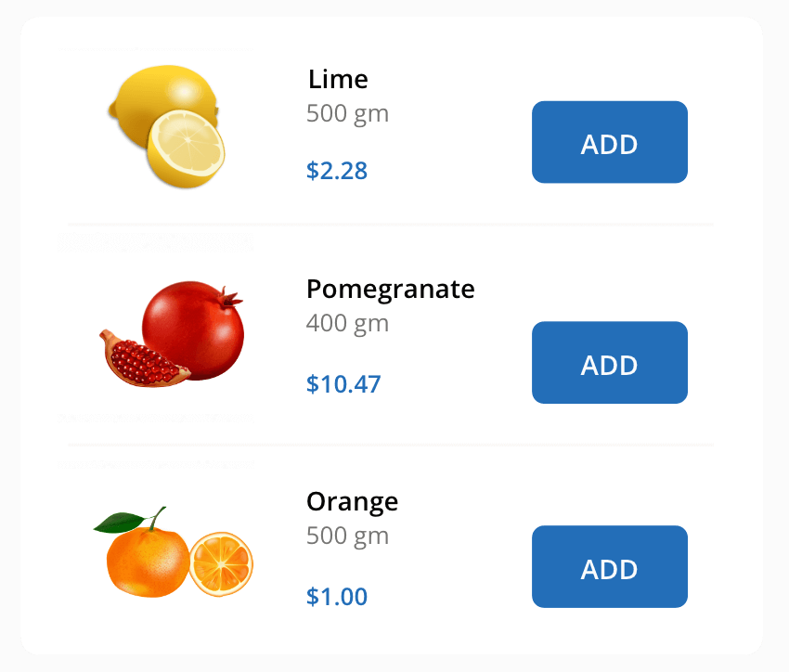
LISTVIEW
The List View renders a set of data items with UI views or custom templates. It has many features like grouping, sorting, filtering, paging, swiping, multiple selection, drag and drop, and different layout types. The List View control has been optimized to work with large amounts of data.
SUPPORTED PLATFORMS
JavaScript | Angular | React | Vue | Blazor
Flutter | ASP.NET MVC | ASP.NET Core
Winforms | WPF | WinUI | Flutter | Xamarin
UWP | .NET MAUI
Xamarin | Flutter | UWP | JavaScript | .NET MAUI

